Slide 1
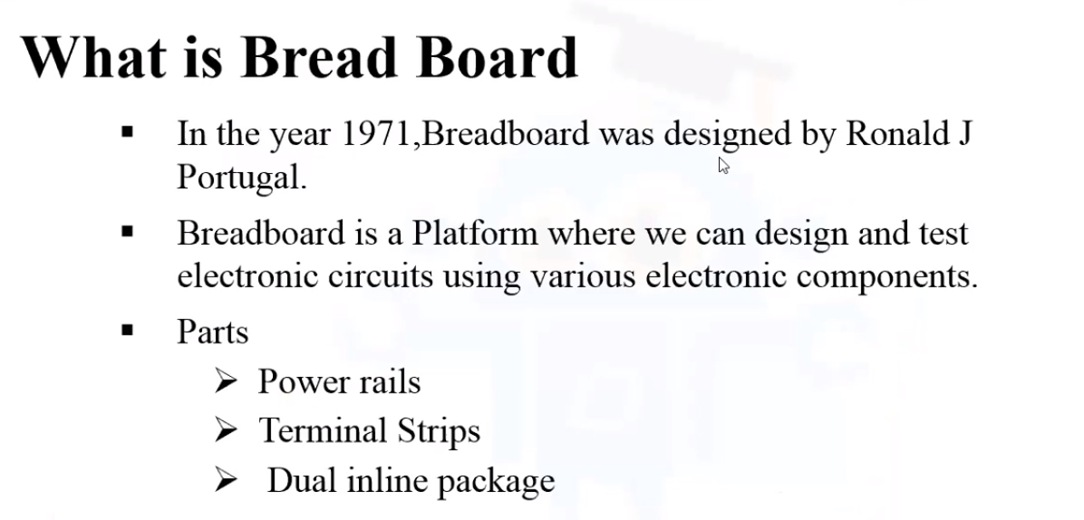
Breadboard
Presented by Jatasya Raval AKA Mad Genius

Slide 2
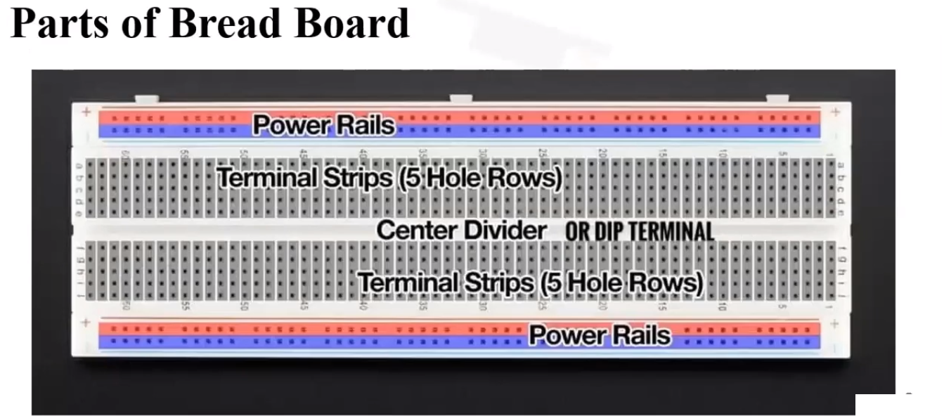
Breadboard
Presented by Jatasya Raval AKA Mad Genius

Slide 3
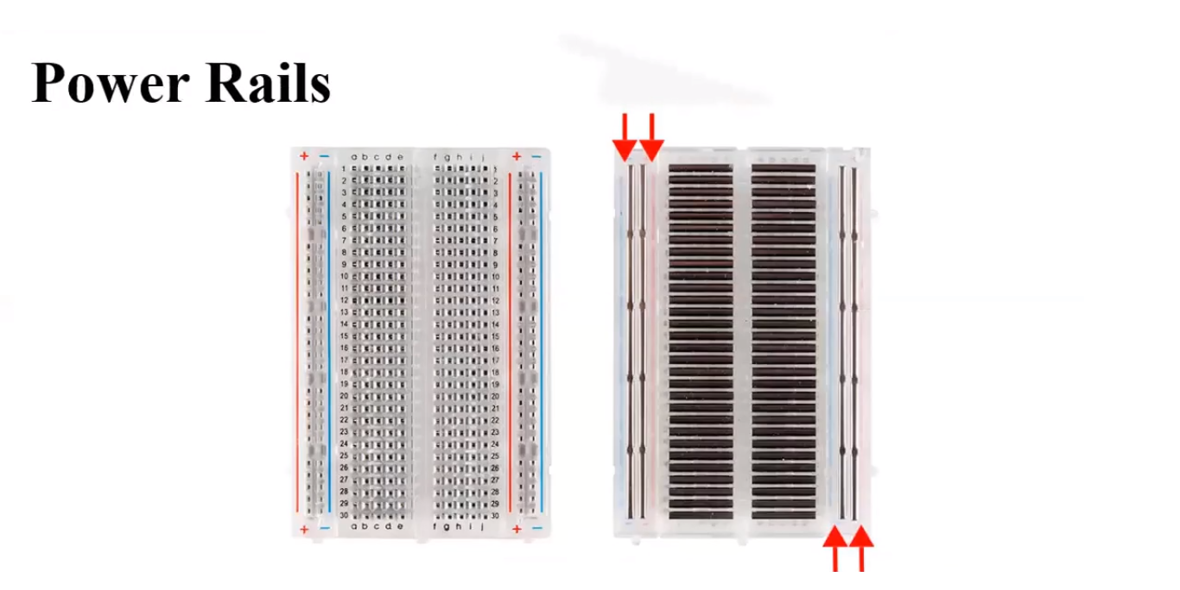
Breadboard
Presented by Jatasya Raval AKA Mad Genius

Slide 4
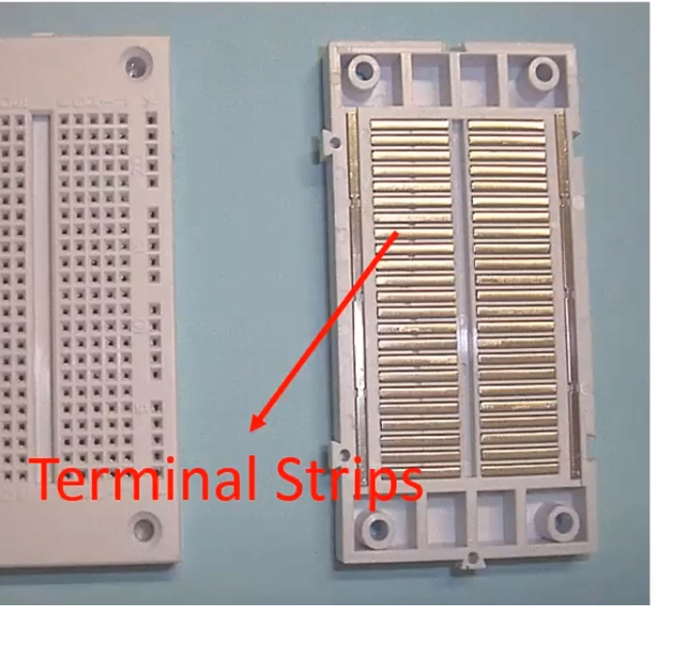
Breadboard
Presented by Jatasya Raval AKA Mad Genius

Slide 5
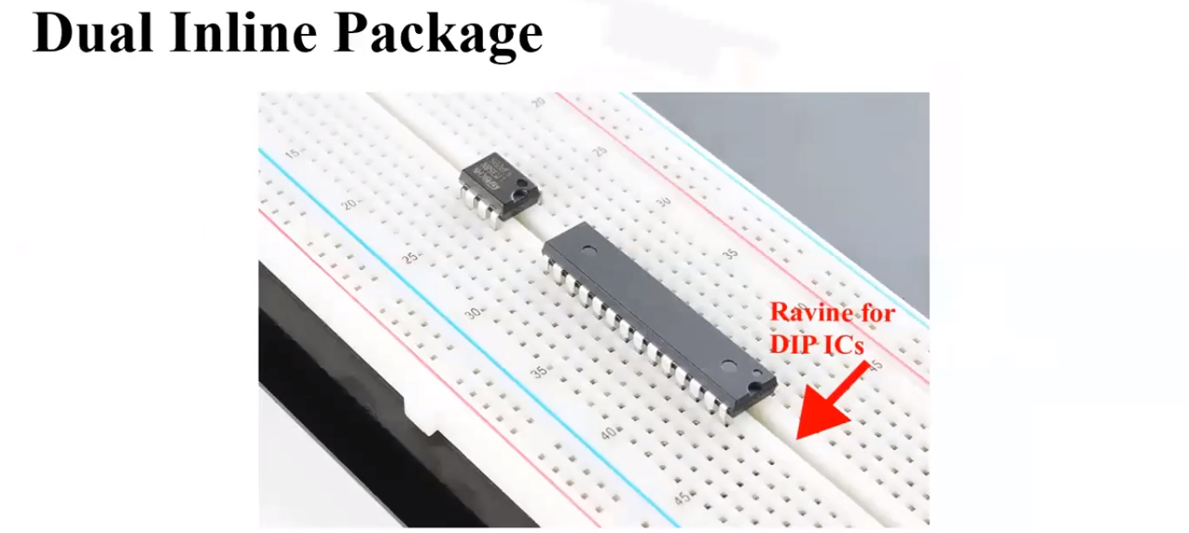
Breadboard
Presented by Jatasya Raval AKA Mad Genius

Slide 6
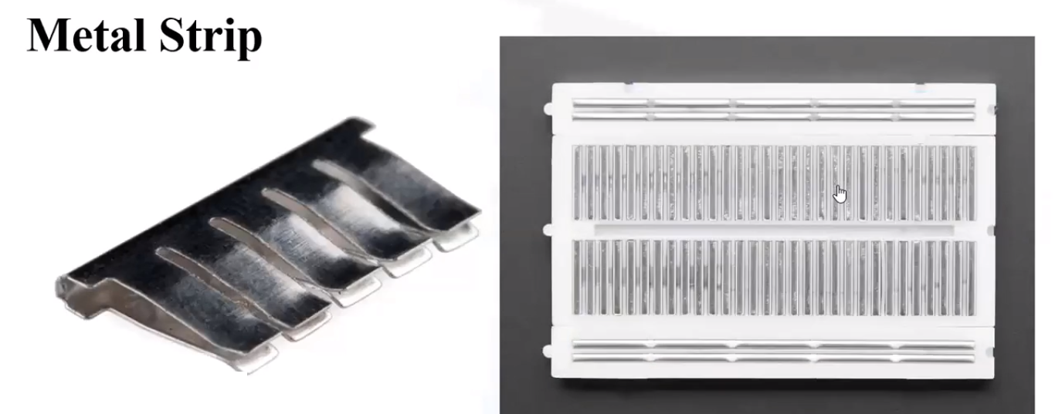
Breadboard
Presented by Jatasya Raval AKA Mad Genius

Slide 7
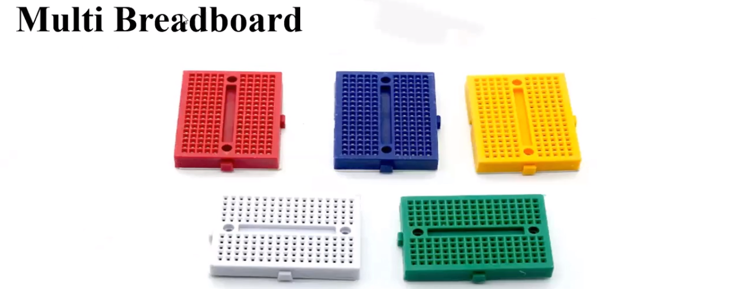
Breadboard
Presented by Jatasya Raval AKA Mad Genius

Slide 8
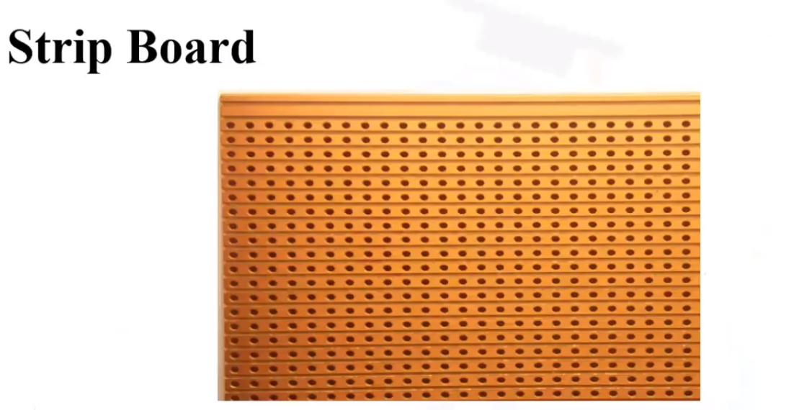
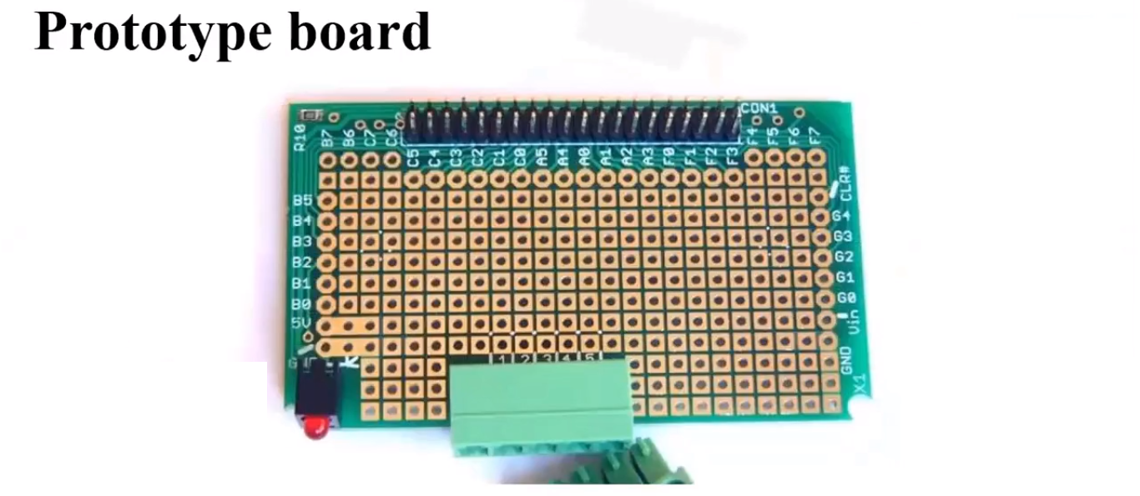
Types of Breadboard
Breadboard
Presented by Jatasya Raval AKA Mad Genius
Breadboard
Presented by Jatasya Raval AKA Mad Genius

Slide 9
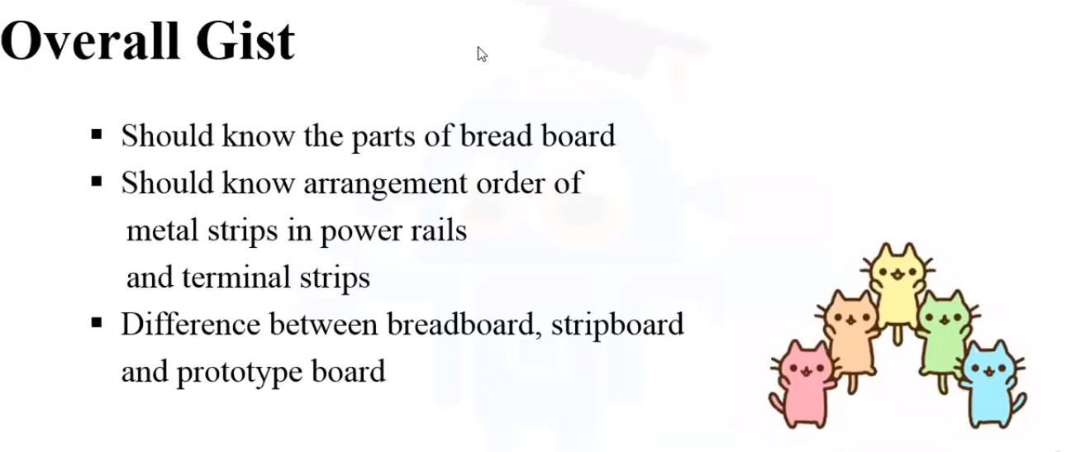
Breadboard
Presented by Jatasya Raval AKA Mad Genius

